Slide 1

MySQL
The products, features and Concepts

Slide 2

MySQL Overview and Products
What is MySQL
MySQL Products
MySQL Supported Operating Systems

Slide 3
MySQL
MySQL, the most popular Open Source SQL database management system, is developed, distributed, and supported by Oracle Corporation.
MySQL is a database management system.
MySQL databases are relational.
MySQL software is Open Source.
The MySQL Database Server is very fast, reliable, scalable, and easy to use.
MySQL Server works in client/server or embedded systems.
A large amount of contributed MySQL software is available.
https://dev.mysql.com/doc/refman/8.0/en/what-is-mysql.html

Slide 4
MySQL Products
Commercial customers have the flexibility of choosing from multiple editions to meet specific business and technical requirements:
MySQL Standard Edition
MySQL Enterprise Edition
MySQL Cluster Carrier Grade Edition
MySQL HeatWave
See comparison and pricing:
https://www.mysql.com/products/

Slide 5
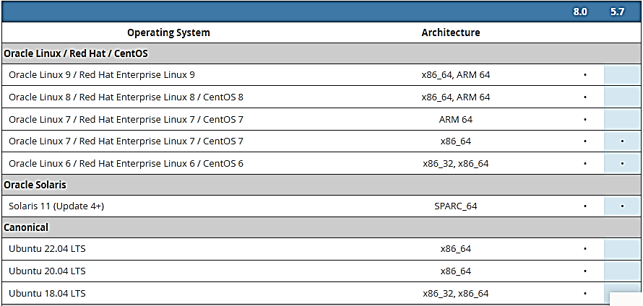
Supported Platforms

Slide 6
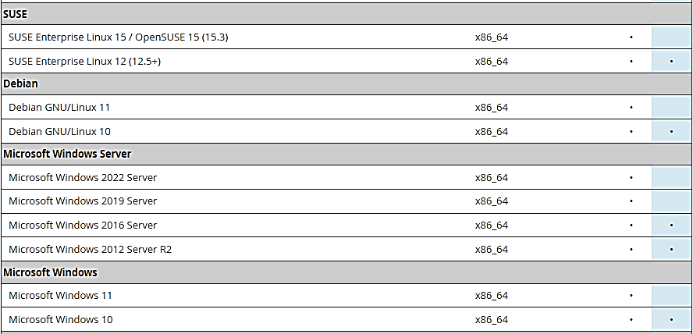
Supported Platforms

Slide 7
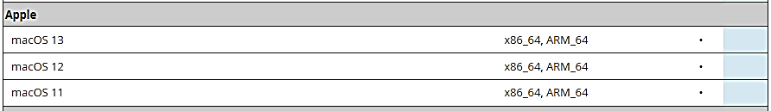
Supported Platforms

Slide 8
MySQL Learning
Training paths
Documentation Resources

Slide 9
MySQL Training Path
Getting Started with MySQL
MySQL Database Administration
MySQL Development
Securing MySQL
MySQL Cluster Administration
MySQL for Oracle DBAs
MySQL Advanced Features

Slide 10
MySQL Documentation Resources
The official MySQL Documentation from Oracle can be found here: https://dev.mysql.com/doc/
It is highly recommended to download a pdf copy for offline reading and reference.

Slide 11
MySQL Architecture
MySQL Architecture
Client / Server Model
Communication Protocols

Slide 12
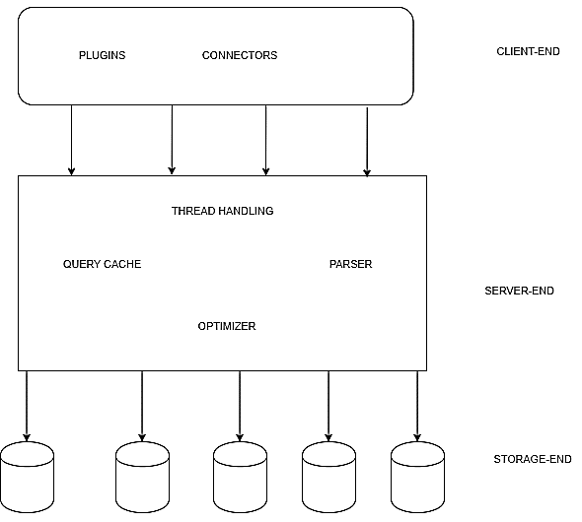
MySQL Architecture
MYSQL is a relational database with a layered kind of architecture. The layers of the architecture include a server resource end at the middle, the storage engine at the bottom, and the client-end or query execution end at the top. It’s a three-layered architecture database system.
The architecture of the database explains the relationship and interaction between the client-end, server-end, and storage-end of the system. Below are the various layers of the database system.

Slide 13
MySQL Architecture
Client-end
The client-end of the MYSQL architecture is the part being interacted with by end-users of the database system. The user makes use of the graphic user interface screen or the command prompt for submission of various MYSQL commands to the server end.
For every valid command submission, there is a valid output on the screen; for every wrong command submission, there is an error message sent as feedback to the screen. When a user sends a request to the server-end and the server accepts the request, a connection is established at once to enable the user carry out further requests. This could be termed connection handling, and it’s a function rendered by the client-side of the architecture.

Slide 14
MySQL Architecture
Server-end
The server-end of the architecture comprises the logic of the database system. It is the brain of the MYSQL architecture. It receives every request sent by the client-side and also returns feedback upon processing every request.
For every request sent by the client, there is an establishment of a connection, this connection is known as a thread on the server-side. The server end of the architecture helps in managing every established thread and this is known as thread handling. Thread handling is a function carried out by the server-end of the architecture.

Slide 15
MySQL Architecture
Storage-end
The MYSQL database contains a different kind of storage engines which exist as a result of varying needs of databases. The storage engines are used to hold every user-created table in the database system. The storage-end facilitates the storing and retrieving of MYSQL data. The storage engine has an API that aids in the execution of the queries from the client end of the architecture just by passing rows back and forth in it.

Slide 16
MySQL Features (p.1)
MYSQL language is easy to use as compared to other programming language like C,C++, Java etc. By learning with some basic command we can work , create and interact with Database.
MYSQL consist of Data Security layer which protect the data from violator. Also, passwords are encrypted in MYSQL.
MYSQL follow Client-Server Architecture where Client request Commands and instructions and Server will produce output as soon as the instruction is matched.
MYSQL is free to use under Community version of it. So we can download it from MYSQL website and work on it freely.
MYSQL use multithreading which makes it Scalable. It can handle any amount of data .The default file size limit is 4 GB, but we can increase it according to our need.
MYSQL is considered as one of the fast database. It’s fastness is determined on the basis of large number of benchmark tests.

Slide 17
MySQL Features (p.2)
MYSQL is very flexible because it supports large number of embedded systems.
MYSQL is compatible to run on various operating system such as Windows, MacOS , Linux etc.
MYSQL allow transactions to be rolled back, commit and cash recovery.
It has low memory leakage problem which increase its memory efficiency.
MYSQL version 8.0 provide dual password support , one is a current password and another is secondary password. With the help of this we can create new password.
MYSQL provide feature of Partitioning which improve performance of large databases.

Slide 18
MySQL Communication Protocol
For programs that use the MySQL client library (for example, mysql and mysqldump), MySQL supports connections to the server based on several transport protocols: TCP/IP, Unix socket file, named pipe, and shared memory.

Slide 19
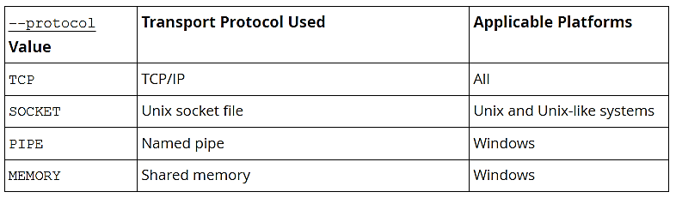
MySQL Communication Protocol
Transport Protocol Selection
For a given connection, if the transport protocol is not specified explicitly, it is determined implicitly. For example, connections to localhost result in a socket file connection on Unix and Unix-like systems, and a TCP/IP connection to 127.0.0.1 otherwise.
To specify the protocol explicitly, use the --protocol command option. The following table shows the permissible values for --protocol and indicates the applicable platforms for each value. The values are not case-sensitive.

Slide 20
MySQL Communication Protocol
Transport Support for Local and Remote Connections
TCP/IP transport supports connections to local or remote MySQL servers.
Socket-file, named-pipe, and shared-memory transports support connections only to local MySQL servers. (Named-pipe transport does allow for remote connections, but this capability is not implemented in MySQL.)

Slide 21
MySQL Storage Engines
MySQL Storage Layer
Storage Engines
MySQL Memory and Disk Space

Slide 22
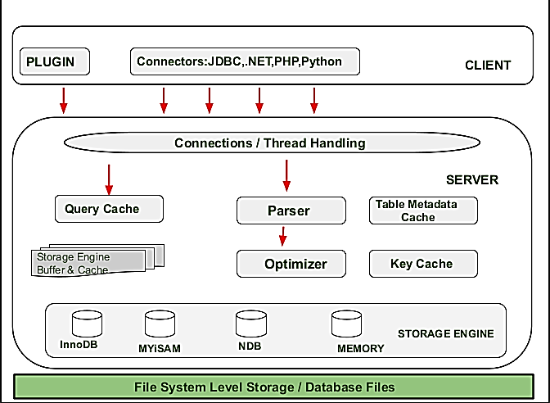
MySQL Layers

Slide 23
MySQL Storage Layer
The Storage Engine Layer of MYSQL Architecture make it’s unique and most preferable for developer’s . Due to this Layer MYSQL layer is counted as the mostly used RDBMS and is widely used. In MYSQL server , for different situations and requirement’s different types of storage engines are used which are InnoDB ,MYiSAM , NDB ,Memory etc. These storage engines are used as pluggable storage engineer where tables created by user are plugged with them.

Slide 24
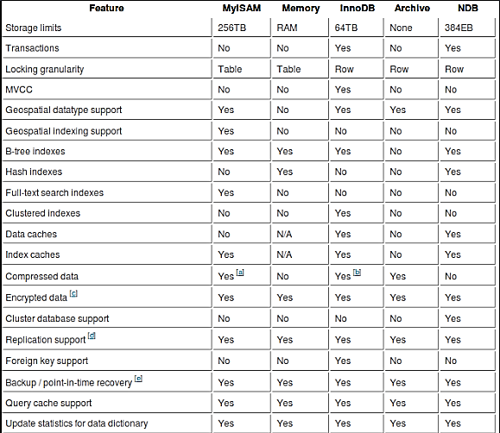
MySQL Storage Engines

Slide 25
MySQL Storage Engines
InnoDB: InnoDB is a storage engine for DBMS MySQL and MariaDB.It is the default storage engine for MySQL versions 5.5 and higher. It replaced MyISAM as the default engine.
Features:
It provides standard ACID-compliant transaction features, along with foreign key support. Oracle recommends InnoDB for tables.
It supports multi-version concurrency control, crash-recovery, and rollback operations. Multi-user performance is possible due to row-level locking.
It is used in the MariaDB server too. To maintain data integrity and security, InnoDB supports foreign key constraints.
InnoDB supports buffers that cache data as well as indexes.
It offers a table locking method, which means only one user can alter the table at a time.
Advantages:
Supports ACID (Atomicity, Consistency, Isolation, and Durability) properties for securing user’s data.
Access to multiple users with high performance and consistent reads in Oracle-style.
Supports usage of foreign keys that help in the consistent update, insert and delete operations. Also, it helps in maintaining integrity in the contents of the tables of the database.
Disadvantages:
Does not support full-text search.
If performance is a priority then it is not used because it is slower than MyISAM.
Usage of foreign key relationships makes it complex to use.

Slide 26
MySQL Storage Engines
MyISAM: It is the default engine for MySQL DBMS versions prior to 5.5.MyISAM is a high-speed storage and retrieval storage engine. It doesn’t support transactions. It is easy to copy between systems and has a small data footprint. Mostly used in Web and Data Warehousing.
Features:
MyISAM is stored in 3 files: .frm – Stores table format, .MYD – Data files, .MYI – index file.
It supports three storage formats: Fixed, Dynamic, and Compressed.
The maximum key length is 1000 bytes.
The maximum number of indexes per table and columns per index are 64 and 16 respectively.
Advantages:
MyISAM is simpler than other engines.
It is faster than any other general-purpose database engine. It also provides a full-text searching
Disadvantages:
It can easily lead to corruption of the table. However, we can use the REPAIR TABLE query to recover it.
It does not support foreign key constraints or transactions.

Slide 27
MySQL Storage Engines
CSV: It is used to store CSV format in a text file. It is always compiled into the MySQL server. It is lightweight and can be easily imported into spreadsheet programs.
Features:
CSV tables use CSV format.Thus, it can be used for data exchange for eg. using the spreadsheet.
Editing data can be performed even if the MySQL server is down using standard file editors
Instantaneous loading of massive data in the MySQL server.
Advantages:
Metafile is created that stores the state of the table and the number of rows that exist in the table after creating the CSV file.
Data is stored in a text file using the common-separated value format.
Disadvantages:
CSV engine does not support indexing.
It does not support partitioning.
It must have NOT NULL attributes on all columns.

Slide 28
MySQL Storage Engines
MERGE: Tables created using the MERGE engine are used to handle a large volume of data easily. It is a collection of identical MyISAM tables that can be used as one. Thus, it is also known as the MRG_MyISAM engine. It is good for data warehousing environments.
Features:
It was introduced in MySQL 3.23.25 version.
UNION and INSERT_METHOD are two unique features of MERGE tables.
MERGE tables do not have PRIMARY KEY or UNIQUE indexes as they cannot enforce uniqueness over all tables.
Advantages:
It is a collection of identical MyISAM tables that can be used as one table. Memory is saved due to it.
It can perform the most efficient repair of individual tables rather than repairing a single large table which is made by merging these individual tables.
Merge tables are not limited to the file size of the operating system, unlike MyISAM tables.
Disadvantages:
Only identical MyISAM tables can be used to merge.
If the MERGE table is nontemporary, it is necessary for merge tables to be nontemporary. If the MERGE table is temporary, the MyISAM tables can be a mixture of temporary and nontemporary.
Some MyISAM features are not available in MERGE tables.

Slide 29
MySQL Storage Engines
MEMORY: It is considered to be the fastest engine used to usually create temporary tables in memory (also known as HEAP). Thus data is lost when the database is restarted. It is non-transactional. It is useful for quick looks up of references and other identifying data. It stores all data in RAM for faster access rather than storing data in disks. It is widely used for read-only caches of data from tables or for temporary usage.
Features:
It does not create any files on disk.
MEMORY tables cannot contain BLOB or TEXT columns.
AUTO_INCREMENT columns are supported.
VARCHAR is stored using fixed-length i.e. it uses fixed-length row-storage format.
Advantages:
Data is encrypted which is implemented in the server via encryption functions.
Supports B-tree indexes.
Offers low-level locking and multiple-thread operation for low contention between clients.
Disadvantages:
MEMORY tables cannot be partitioned.
Memory can’t be reclaimed if you delete individual rows from a MEMORY table

Slide 30
MySQL Storage Engines
SEQUENCE: It is the transactional engine used for creating ascending or descending sequences of positive integers with given initial, end, and increment values. It is read-only and supports XA.
Features:
Like the MEMORY database engine, it does not create any file on a disk.
It creates virtual tables automatically whenever we need them. There is no way to create a SEQUENCE table explicitly.
This engine is useful with joins and subqueries.
Advantages:
SEQUENCE engine is not bound to tables. Thus, we can use them for any other purpose too.
Flexibility in implementation of the table.
Disadvantages:
Additional programming is required for the AUTO_INCREMENT feature which is not available in the engine by default.
Concurrency issue when there are multiple parallel sessions active.

Slide 31
MySQL Memory and Disk Space
How MySQL Uses Memory
MySQL allocates buffers and caches to improve performance of database operations. The default configuration is designed to permit a MySQL server to start on a virtual machine that has approximately 512MB of RAM. You can improve MySQL performance by increasing the values of certain cache and buffer-related system variables. You can also modify the default configuration to run MySQL on systems with limited memory.

Slide 32
MySQL Memory and Disk Space
In typical cases, you mainly only have innodb_buffer_pool_size to worry about. But you might also need to consider key_buffer_size, query_cache_size as well as table_cache and table_open_cache. These are also responsible for global memory allocation, even though they are not counted in bytes. Performance _Schema may also take a lot of memory, especially if you have a large number of connections or tables in the system.
When you specify the size of the buffers and caches, you should determine what you’re specifying. For innodb_buffer_pool_size, remember there is another 5-10% of memory that is allocated for additional data structures – and this number is larger if you’re using compression or set innodb_page_size smaller than 16K.
For systems with large amounts of memory, the database cache is going to be by far the largest memory consumer, and you’re going to allocate most of your memory to it. When you add extra memory to the system, it is typically to increase the database cache size.

Slide 33
MySQL Memory and Disk Space
To quickly increase performance, table_cache is the most useful configuration directive to change. Each time MySQL accesses a table, it loads the table into cache. If you've got a high number of tables, it's faster to have them cached.
Take a look at your server variables by running:
show status;
and have a look for the variable open_tables. If this is the same as your table_cache value, and opened_tables keeps going up, then you need to increase the table_cache value in your configuration file. You'll find a balance by experimenting with these variables during peak times. You want to configure it so that at peak times, there are a low amount of opened_tables even after the server has been up for a long time.
key_buffer_size is also a good variable to experiment with. This variable affects the index buffer size, and making this variable bigger increases MySQL's index handling speed. You can look at the variables with the show variables; command again, and compare key_read_requests to key_reads. Ideally, you want the ratio between these two variables to be as low as possible, and you can do this by increasing the size of the key_buffer_size. If you set this variable higher, you will have less writes and reads directly to and from the disk, which was your main concern.

Slide 34
MySQL Memory and Disk Space
The best way to perform a disk usage operation is by using the information_schema to query the database directly. To do so, you can use the following command. Be sure to replace $DATABASE with the actual name of your database.
mysql -e 'SELECT table_schema "Database (table_schema)", sum((data_length+index_length)/1024/1024/1024) AS "DB size in GB" FROM information_schema.tables WHERE table_schema = "$DATABASE";'

Slide 35
MySQL System Administration
MySQL Distributions
Installing
File Structure
Starting and Stopping
Running multiple instances

Slide 36
MySQL Distributions
When preparing to install MySQL, decide which version and distribution format (binary or source) to use.
First, decide whether to install a development release or a General Availability (GA) release. Development releases have the newest features, but are not recommended for production use. GA releases, also called production or stable releases, are meant for production use. We recommend using the most recent GA release.
For most use cases, a binary distribution is the right choice. Binary distributions are available in native format for many platforms, such as RPM packages for Linux or DMG packages for macOS. Distributions are also available in more generic formats such as Zip archives or compressed tar files. On Windows, you can use the MySQL Installer to install a binary distribution.
Under some circumstances, it may be preferable to install MySQL from a source distribution:
You want to install MySQL at some explicit location. The standard binary distributions are ready to run at any installation location, but you might require even more flexibility to place MySQL components where you want.
You want to configure mysqld with features that might not be included in the standard binary distributions.
You want to configure mysqld without some features that are included in the standard binary distributions.
You want to read or modify the C and C++ code that makes up MySQL. For this purpose, obtain a source distribution.
Source distributions contain more tests and examples than binary distributions.

Slide 37
MySQL Installation (Windows)
MySQL Community Server (installer)
https://dev.mysql.com/downloads/installer/
MySQL Community Server (noinstall zip archive)
https://dev.mysql.com/downloads/mysql/
MySQL Workbench
https://dev.mysql.com/downloads/workbench/
For MySQL 8.0, there are multiple installation package formats to choose from when installing MySQL on Windows. The package formats described in this section are:
MySQL Installer
MySQL noinstall ZIP Archives
MySQL Docker Images

Slide 38
MySQL Installation (Windows)
MySQL Installer requires Microsoft .NET Framework 4.5.2 or later.
MySQL Installer Community Release
Download software from https://dev.mysql.com/downloads/installer/ to install the Community release of all MySQL products for Windows. Select one of the following MySQL Installer package options:
Web: Contains MySQL Installer and configuration files only. The web package option downloads only the MySQL products you select to install, but it requires an internet connection for each download. The size of this file is approximately 2 MB. The file name has the form mysql-installer-community-web-VERSION.N.msi in which VERSION is the MySQL server version number such as 8.0 and N is the package number, which begins at 0.
Full or Current Bundle: Bundles all of the MySQL products for Windows (including the MySQL server). The file size is over 300 MB, and the name has the form mysql-installer-community-VERSION.N.msi in which VERSION is the MySQL Server version number such as 8.0 and N is the package number, which begins at 0.
MySQL Installer Commercial Release
Download software from https://edelivery.oracle.com/ to install the Commercial release (Standard or Enterprise Edition) of MySQL products for Windows. If you are logged in to your My Oracle Support (MOS) account, the Commercial release includes all of the current and previous GA versions available in the Community release, but it excludes development-milestone versions. When you are not logged in, you see only the list of bundled products that you downloaded already.
The Commercial release also includes the following products:
Workbench SE/EE
MySQL Enterprise Backup
MySQL Enterprise Firewall

Slide 39
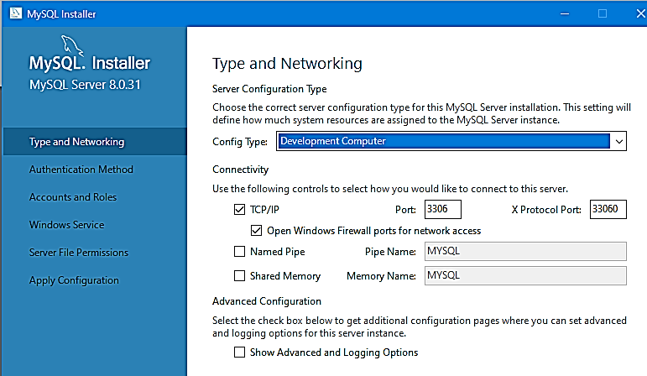
MySQL Installation (Windows)

Slide 40
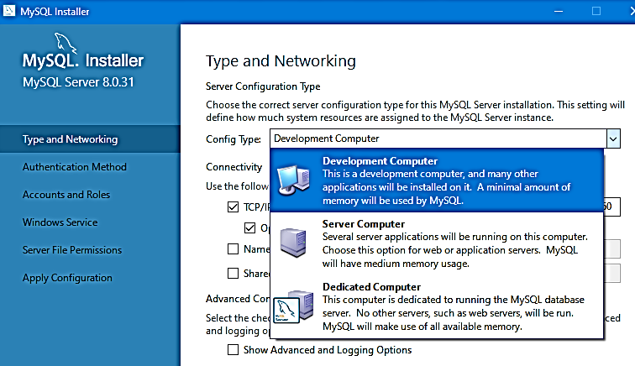
MySQL Installation (Windows)

Slide 41
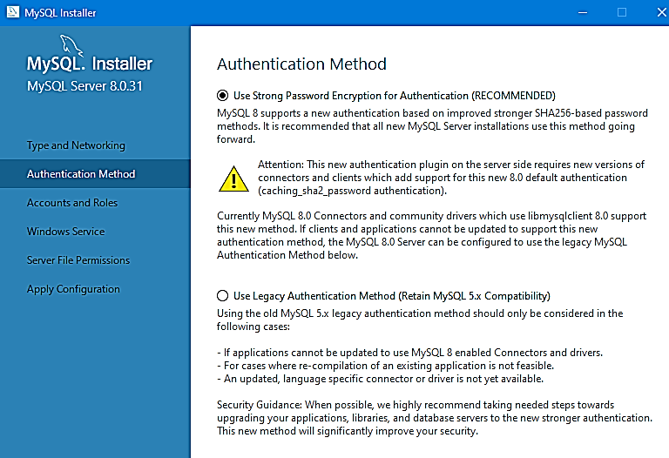
MySQL Installation (Windows)

Slide 42
MySQL Installation (Windows)

Slide 43
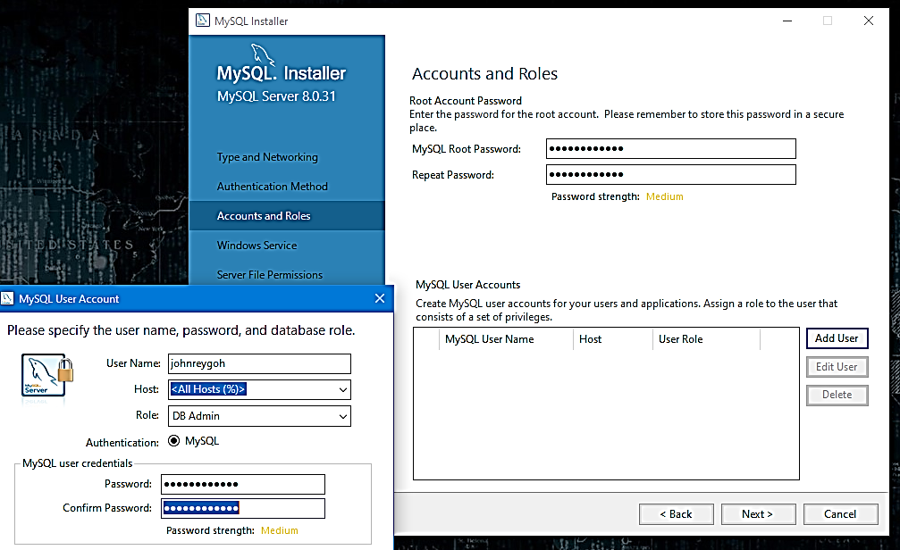
MySQL Installation (Windows)

Slide 44
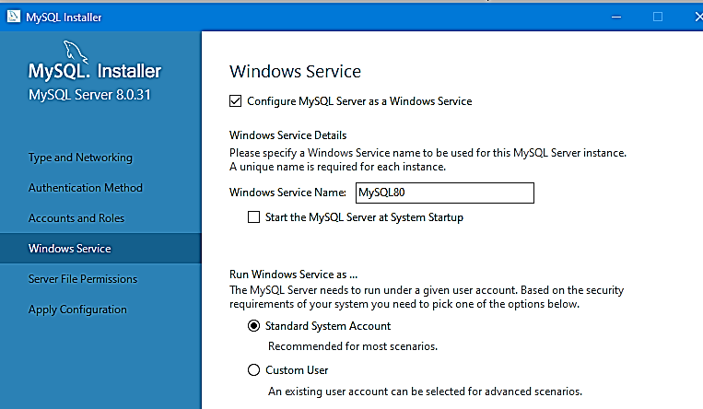
MySQL Installation (Windows)

Slide 45
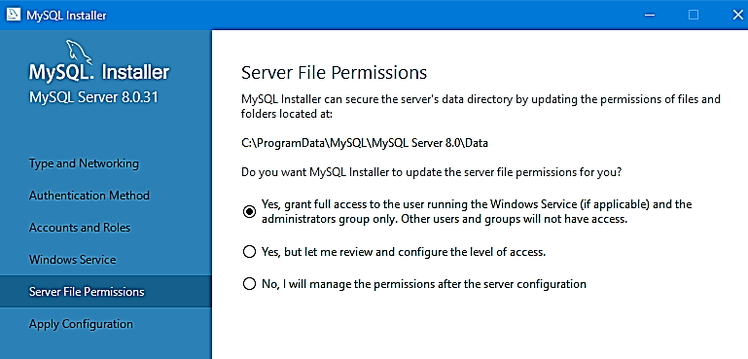
MySQL Installation (Windows)

Slide 46
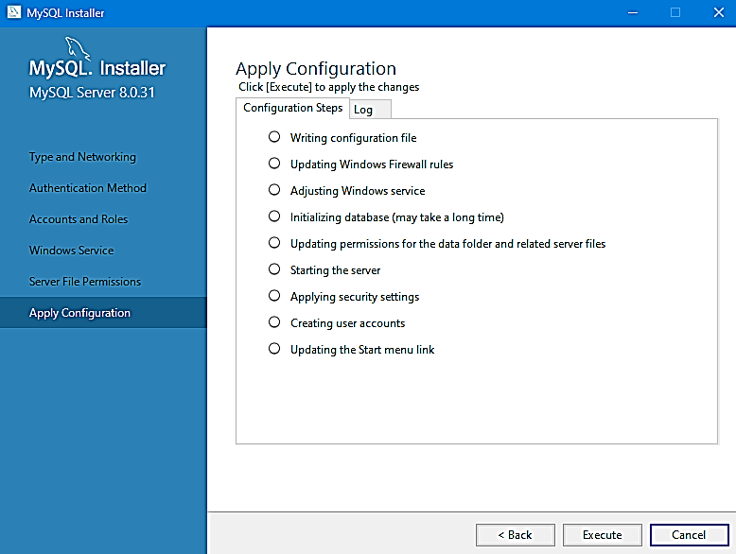
MySQL Installation (Windows)

Slide 47
MySQL Installation (Windows)
If you installed MySQL using MySQL Installer, the default installation directory is C:\Program Files\MySQL\MySQL Server 8.0:
C:\> cd "C:\Program Files\MySQL\MySQL Server 8.0"
A common installation location for installation from a ZIP archive is C:\mysql:
C:\> cd C:\mysql
Alternatively, add the bin directory to your PATH environment variable setting. That enables your command interpreter to find MySQL programs properly, so that you can run a program by typing only its name, not its path name.
With the server running, issue the following commands to verify that you can retrieve information from the server. The output should be similar to that shown here.
Use mysqlshow to see what databases exist:
C:\> bin\mysqlshow
+--------------------+
| Databases
+--------------------+
| information_schema
| mysql
| performance_schema
| sys
+--------------------+

Slide 48
MySQL Installation (Windows)
The preceding command (and commands for other MySQL programs such as mysql) may not work if the correct MySQL account does not exist. For example, the program may fail with an error, or you may not be able to view all databases. If you install MySQL using MySQL Installer, the root user is created automatically with the password you supplied. In this case, you should use the -u root and -p options. (You must use those options if you have already secured the initial MySQL accounts.) With -p, the client program prompts for the root password. For example:
C:\> bin\mysqlshow -u root -p
Enter password: (enter root password here)
+--------------------+
| Databases
+--------------------+
| information_schema
| mysql
| performance_schema
| sys
+--------------------+
If you specify a database name, mysqlshow displays a list of the tables within the database:
C:\> bin\mysqlshow mysql
Database: mysql
+---------------------------+
| Tables
+---------------------------+
| columns_priv
| component
| db
| default_roles

Slide 49
MySQL Installation (Windows)
Use the mysql program to select information from a table in the mysql database:
C:\> bin\mysql -e "SELECT User, Host, plugin FROM mysql.user" mysql
+------+-----------+-----------------------+
| User | Host | plugin
+------+-----------+-----------------------+
| root | localhost | caching_sha2_password
+------+-----------+-----------------------+

Slide 50

Activity
Download and Install MySQL 8 Community Server using MySQL Installer – Community (Windows)

Slide 51
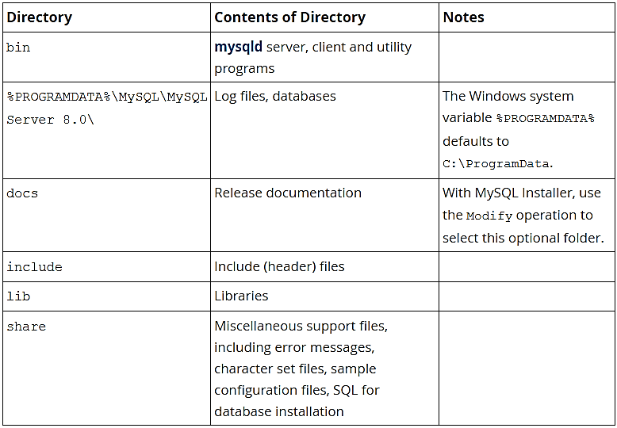
MySQL File Structure
For MySQL 8.0 on Windows, the default installation directory is C:\Program Files\MySQL\MySQL Server 8.0 for installations performed with MySQL Installer.
If you use the ZIP archive method to install MySQL, you may prefer to install in C:\mysql. However, the layout of the subdirectories remains the same.

Slide 52
MySQL File Structure
The \ path name separator character
Path name components in Windows are separated by the \ character, which is also the escape character in MySQL. If you are using LOAD DATA or SELECT ... INTO OUTFILE, use Unix-style file names with / characters:
mysql> LOAD DATA INFILE 'C:/tmp/skr.txt' INTO TABLE skr;
mysql> SELECT * INTO OUTFILE 'C:/tmp/skr.txt' FROM skr;
Alternatively, you must double the \ character:
mysql> LOAD DATA INFILE 'C:\\tmp\\skr.txt' INTO TABLE skr;
mysql> SELECT * INTO OUTFILE 'C:\\tmp\\skr.txt' FROM skr;

Slide 53
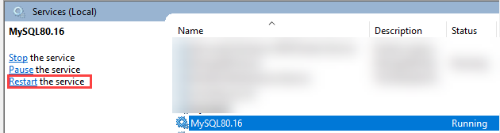
MySQL Starting and Stopping
To stop MySQL Server on Windows:
mysqladmin -u root -p shutdown
To start MySQL Server on Windows:
mysqld
If MySQL installed as a Window service:

Slide 54
MySQL Running Multiple Instances
You can install multiple instances of the MySQL Server using the MySQL Installer. You have to provide them different port (default is 3306), different service instance names, and different data directories.

Slide 55
MySQL Common Installation Issues
Error during Configuration and Initialization. Failed to start process for MySQL Server 8.0.31. Database initialization failed.
Solution 1:
Open the my.ini configuration file that should be found in the following folder:
"C:\ProgramData\MySQL\MySQL Server <version>\my.ini“
Then, open the file and at the end, add the phrase lower_case_table_names=1 (or, if it is already there but it equals a different value, set it up to equal 1) the, save the file and try installing MySQL again.

Slide 56
MySQL vs MariaDB
1. MySQL :
MySQL is an open-source relational database management system(RDBMS) based on Structured Query Language (SQL). It is developed and managed by oracle corporation and initially released on 23 may, 1995. It is widely being used in many small and large scale industrial applications and capable of handling a large volume of data. After the acquisition of MySQL by Oracle, some issues happened with the usage of the database and hence MariaDB was developed.
2. MariaDB :
MariaDB is an open source relational database management system (RDBMS) that is a compatible drop-in replacement for the widely used MySQL database technology. It is developed by MariaDB Foundation and initially released on 29 October 2009. MariaDB has a significantly high number of new features, which makes it better in terms of performance and user-orientation than MySQL.

Slide 57
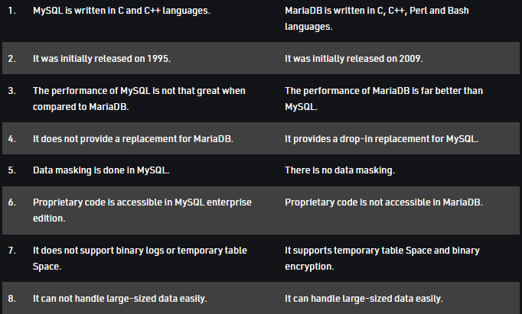
MySQL vs MariaDB

Slide 58
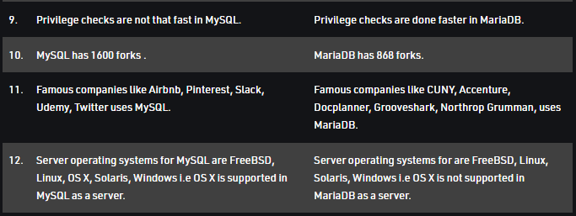
MySQL vs MariaDB

